Slide 1
Social media marketing
Looking for a Social Media Marketer?

Slide 2
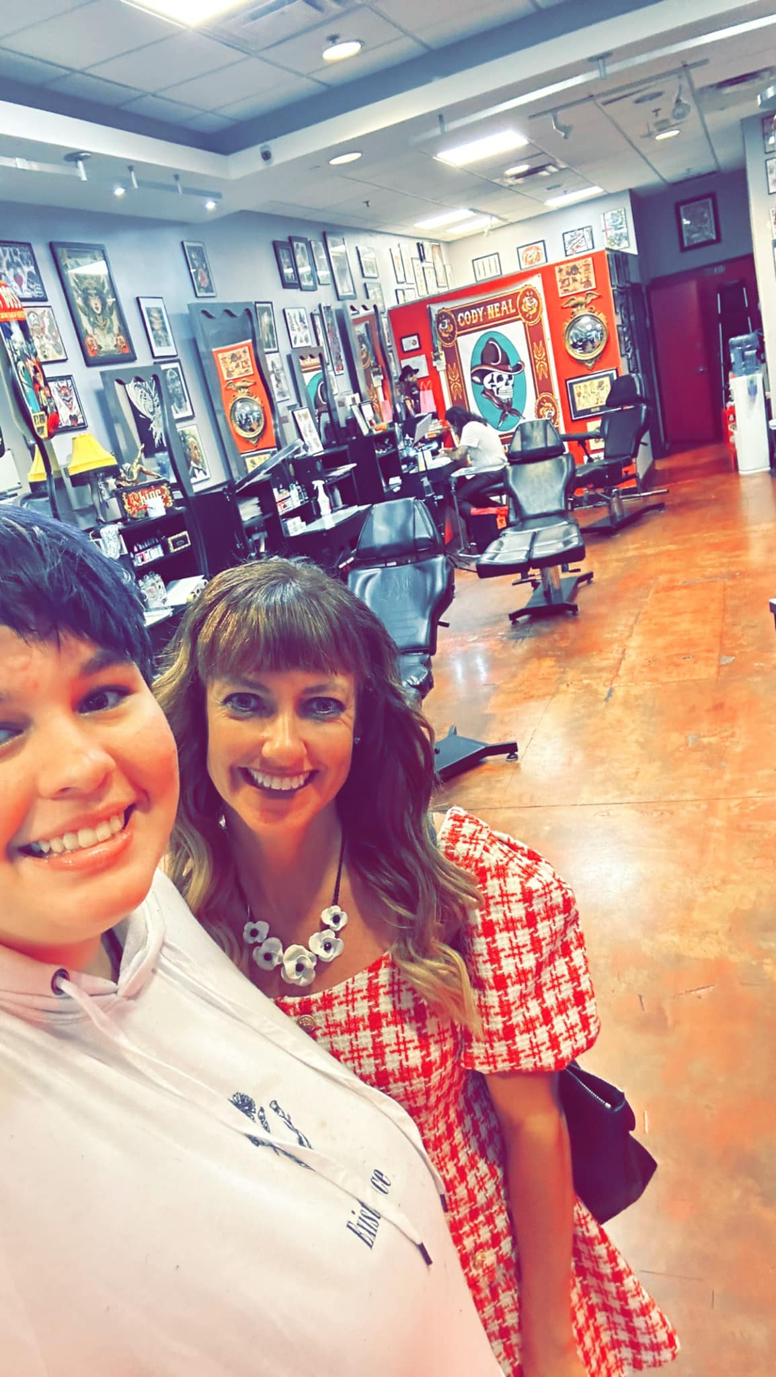
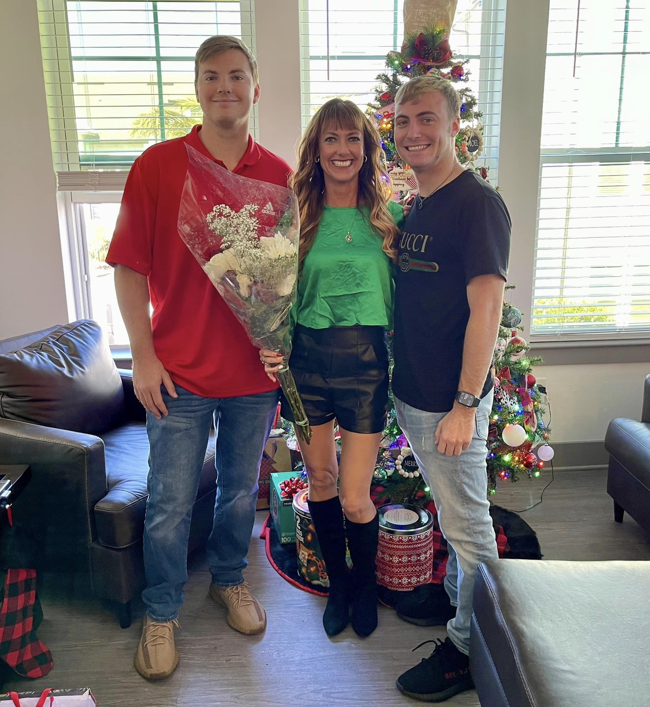

Slide 3
Different Types of Social Media Marketing
Facebook
Twitter
Instagram
Influencer Marketing
Forums
Paid Media
Youtube
Linkedin

Slide 4
Social Media Statistics
The social media landscape is ever-changing and rapidly evolving. Every year, new networks come and go, and social marketing strategies evolve. Every generation of consumers brings new ways of interacting with these social platforms.
* More than HALF of the world’s population uses social media now.
* Around the world, there are 4.88 billion internet users now, which equals almost 62% of the world’s population
* Over the past 12 months, the number of active social media users has increased by more that 400 million.
* More that two-third of the world’s population have access to mobile devices contributing to 5.29 billion unique mobile users. * The average daily usage of social media is 2 hours and 27 mins.

Slide 5
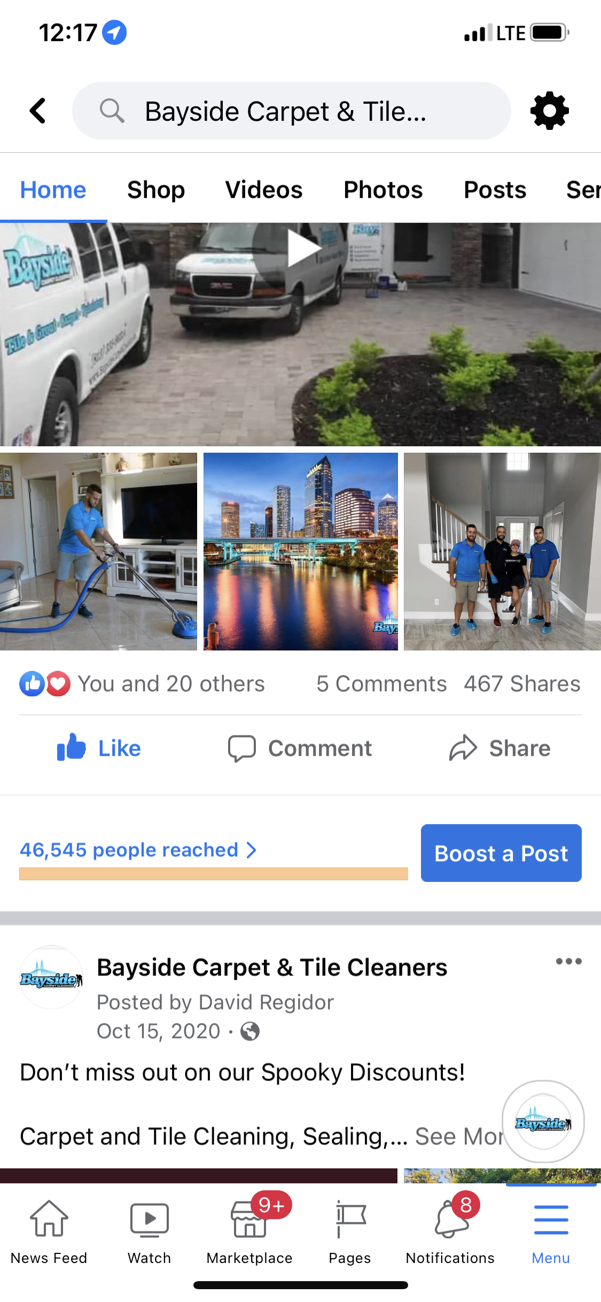
Social Media Growth Marketing
By utilizing community Facebook groups, we communicate your message in a strategic way to create brand awareness, establish yourself as a dominant figure in your community, and most importantly, generate leads for your business.
Similar to how SEO is cracking the code for Google search, we are cracking the code for Social Media organic networking. By commenting, posting, and messaging in these high-volume local groups, we are able to generate up to 10,000-50,000 views a week and, even more importantly, 15-20 leads. Over time these numbers continue to increase.

Slide 6
Streamline Your Social Media To Grow Your Brand
Our Social Media gives you a specialist who works one-on-one with you to organically aid the online presence of your business & brand!
We provide value and opportunities while producing trusted results.
Our focus is to be an extension of your company.
Whether you’re looking to increase your brand awareness, expand your online community, or develop customers, our social media expertise will assist you every step of the way!

Slide 7
Transforming your Social Media presence to generate new business leads and grow your brand without paid ads. Getting more referrals than ever before!
How What We Do Works:
* Join 100’s of Local Groups
Our team goes through your local area and finds 100’s of the most active Facebook community groups and joins them! We will then post in these groups multiple times a week to grow your brand and literally reach thousands of people in your community!
* Generate Referral Leads Like Never Before
We all know referrals are the best type of leads in any business, but until now it’s hard to scale your ability to get referrals. This is the special part! Our team monitors all of these groups for people asking for recommendations for your specific services. We then recommend your company from our personal page and then message them on your behalf to start the conversation for you! When this happens, you will be notified of a new lead in your inbox.

Slide 8
Strategy
A sound Social Media marketing strategy is the backbone of your Social Media presence. Without a strategy, you’re wasting time, unlikely to achieve your goals, and will most likely struggle to reach your target audience.
A good Social Media marketing strategy has clear goals, specific plans to reach those goals, and must be measurable.

Slide 9
Advertising
For anyone looking for an audience, Social Media advertising is worth exploring. With approximately 2.89 billion active users on Facebook alone, that’s an incredible number of prospects.
Main types of advertising consist of Organic, Paid, and Earned. We do all these for you.

Slide 10
Examples of how
Create Content: This includes posts & videos
Promote Content: Create posts that are promoted in community groups
Engage with people: Get active in groups related to your industry, interact with others, and recommend YOU!
Grow a following: Get people to follow your brand by creating and sharing content that appeals to them

Slide 11
Analytics
The success of any Social Media marketing campaign depends on analytics for tracking and collecting data. Without this information you can’t:
Understand user behavior
Refine your strategy
Find which platform works best for your brand
Discover the best times to post
Analyze your competitors
Once you have this, you’ll know with certainty what works and what doesn’t. In turn, analytics will inform the decisions that you make for future campaigns and highly influence the success rate!

Slide 12
Why Choose Our Social Media Services?
Work One-on-One with YOUR own Specialist: You will be assigned your own dedicated Social Media Specialist who works with you to produce creative and unique content.
All Content is Created In-House By Us: Content is not outsourced and is created by our in-house media and graphic design specialists.
Responsive & Attentive Customer Service: All questions or comments are answered fast as we want to be sure any concerns are promptly handled with your ongoing campaign.

Slide 13
About Us
Established in 2015, Just Market It utilizes the latest technology, theory, and trends to create engaging and complete digital marketing solutions custom-tailored to meet the challenges of your market in today’s world.

Slide 14
What Our Customers Think of Us
Hector: “They are extremely professional, courteous, and very knowledgeable in their field!”
Vanessa: “I was immediately impressed with the quality of their product and service.”
Tom: “They offered flexible plans to fit the needs of our company while generating us leads!”

Slide 15
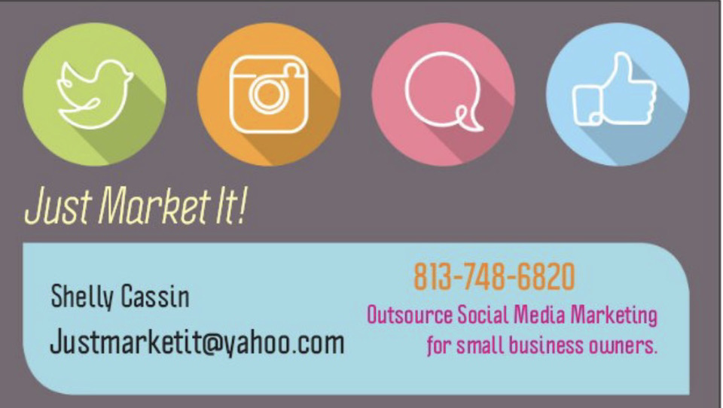
Summary
LOOM VIDEO EXPLAINER
There’s no doubt about it: these days, your business needs to be on Social Media. With 4.48 billion people owning Social Media accounts, there’s a whole world of potential customers that we can access for you!!

Slide 16
Check Us Out Online
www.justmarketitnow.com
(813) 748-6820

